Slide 1
Salaries and Jobs in Database Technology
MSBA 304
Final Project Presentation
Professor Helen Yelluas
Hanqing (Jamie) Huang
Jing Ding (DJ)
Xiangwen (Jessica) Meng
Xiaoting (Theresa) Liu

Slide 2
Database Technology
Content
Introduction & Background
Prospect on Database Technology
Requirements on Database Techonogy
Applicants in Database Technology
Conclusion & Recommendation
Reference

Slide 3
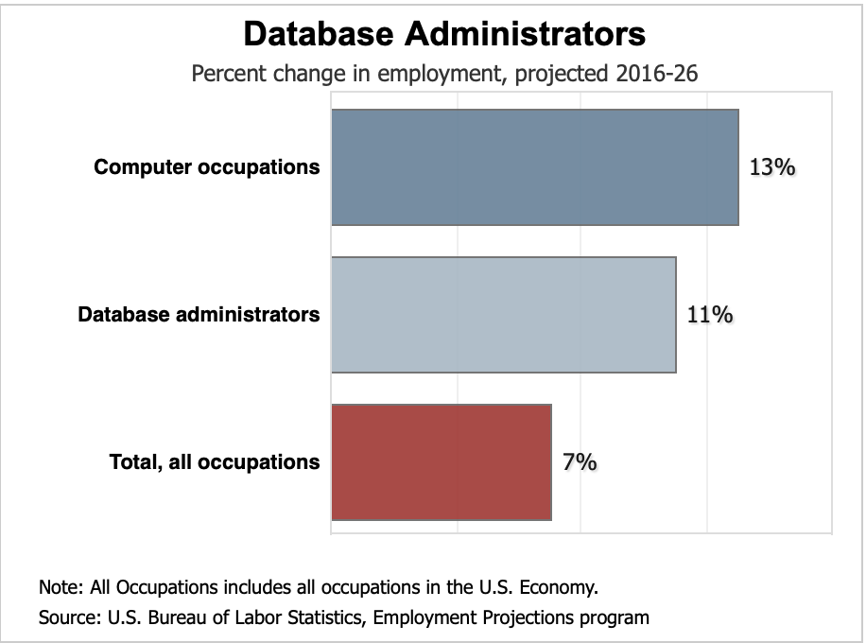
Introduction & Background
According to the U.S. Department of Labor’s Bureau of Labor Statistics,
Database administrators jobs are projected to grow 11 percent by 2026, which is faster than the 7 percent average for all occupations.¹

Slide 4
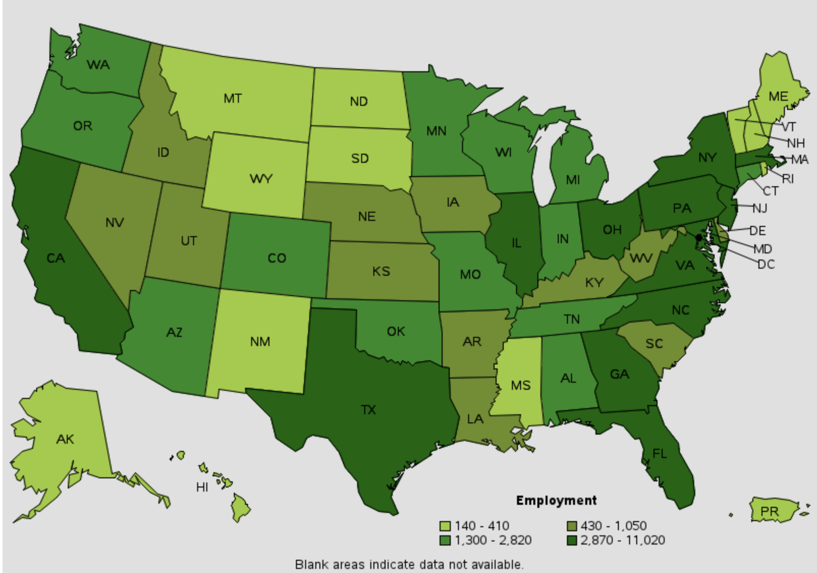
Employment of Database
Related Job, by State in May 2018
State | Employment | Employ per 1000 Jobs | Location quotient | Hourly mean wage | Annual mean wage
TX | 11020 | 0.91 | 1.20 | $45.90 | $95470
CA | 10970 | 0.64 | 0.85 | $45.50 | $100890
NY | 7100 | 0.76 | 0.99 | $47.60 | $99000
FL | 6980 | 0.81 | 1.07 | $41.76 | $86870
VA | 5510 | 1.44 | 1.89 | $47.16 | $98090

Slide 5
Purpose of this presentation
What
What to do？
How
How students can fit in this field?
Why
Why job in database technology field become popular？

Slide 6
Prospect on Database Technology
Why Jobs in Database Technology Field Become Popular?
Database plays a significant role towards a business’s success:
Managing vast amounts of business information (store in databases)
Intergrating all useful data (produce various reports)
Providing insight into market opportunities (data analysis)
Database is expanded from simple storage to creating insight
Important of database management:
Data Access
Data Relationships
Data Updates
Data Searches

Slide 7
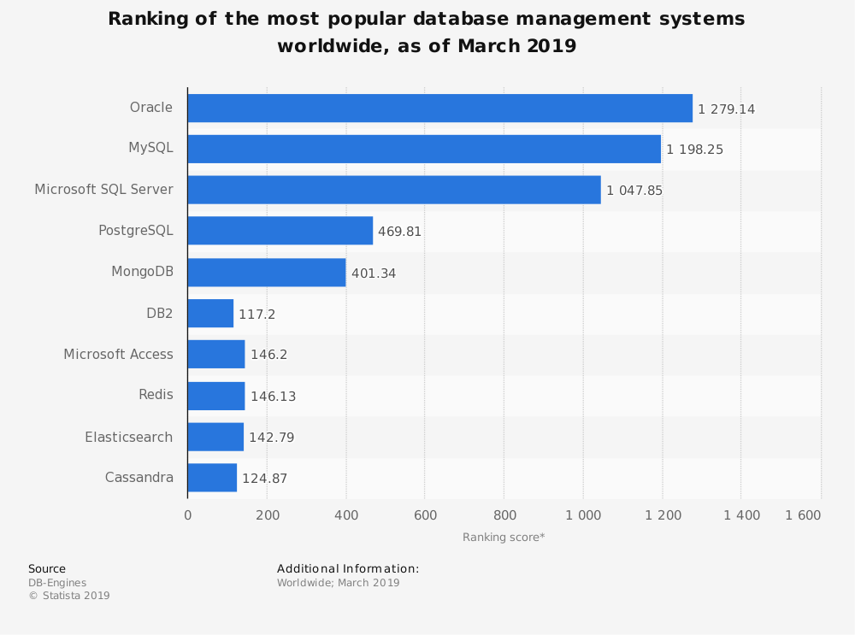
Prospect on Database Technology
Why Jobs in Database Technology Field Become Popular?
Three most popular database management systems were each approximately three times more popular than the next nearest DBMS.
Oracle was the most popular system according to the source's criteria, with a ranking score of 1,279.

Slide 8
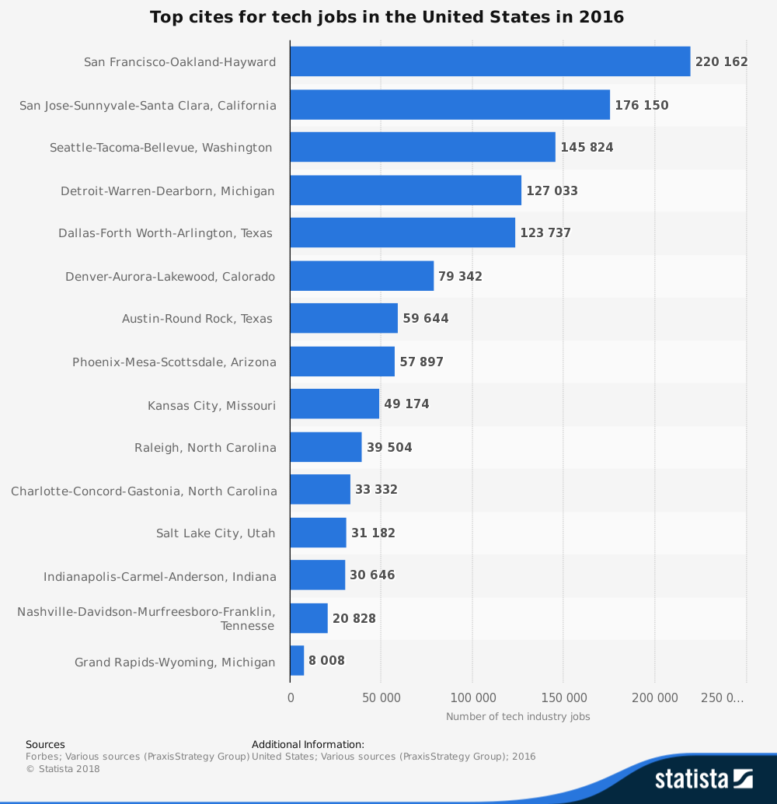
Prospect on Database Technology
Why Jobs in Database Technology Field Become Popular?
San Francisco had 220,000 tech industry jobs, follow by San Jose which had 176,000 jobs.
Bay area had most tech jobs in the United States.

Slide 9
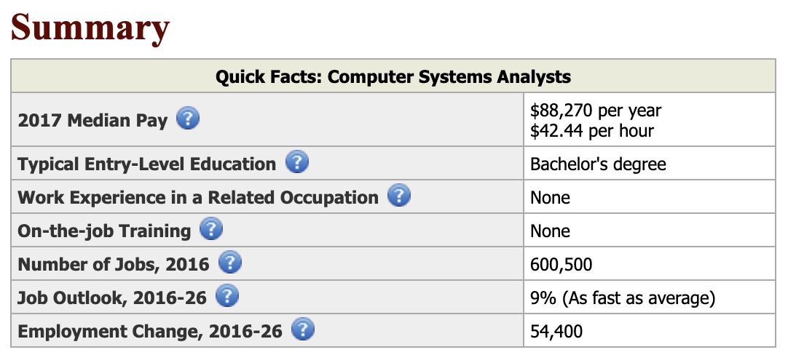
Prospect on Database Technology
Why Jobs in Database Technology Field Become Popular?
The median pay for computer system analyst is $88k in 2017.
Bachelor’s degree is at least needed for jobs in database technology
2017 US Department of Labor

Slide 10
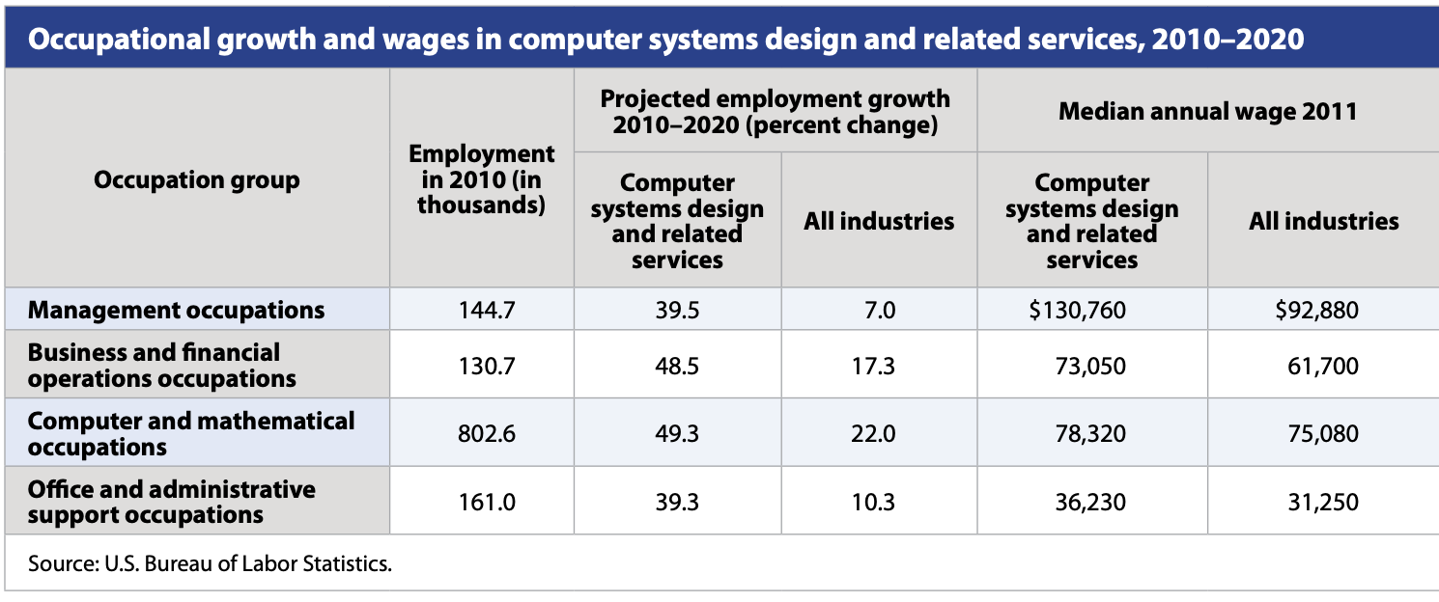
Prospect on Database Technology
Why Jobs in Database Technology Field Become Popular?
Computer and mathematical occupation is the first group that had 802K employment. It is projected that it will have nearly 50% growth from 2010 - 2020.
Management had less employment in 2010 but the median annual wage was higher than computer and mathematical group.

Slide 11
Requirements on Database Techonogy
Career Requirements
Critical Skills:
Acknowledge on Data Technology
Analytical skills;
Theories on data structures and databases
Professional proficiency
Programming capability: C++, JAVA, SQL, C#, PHP and etc.;
Microsoft Office programs
Working Experience: at least of two years of experience
Degree Level: Bachelor's or higher

Slide 12
Requirements on Database Techonogy
Competitiveness Enhancement Process
Step 1: Obtain a Computer Degree
Computer programming, computer information systems, or information technology
Step 2: Keep Skills Current
Learn the newest programming languages
Stay abreast of new developments in computer languages or application specialties
Step 3: Join a Professional Organization
Becoming a member of a computing association
(IEEE Computer Society/ the Association for Computing Machinery)

Slide 13
Required Skills in Marketing (LinkedIn)
Option 2 - Database Administrator
SQL
Computer Science
Application Security
Data Models
Databases
Flow Diagrams
Security Information and event Management (SIEM)
Database Administration
Investigation
RDBMS
Option 1 - Database Engineer
Data Center
SQL
Computer Science
Platform Integration
Databases
MongoDB
Credit
MySQL
Amazon Web Service (AWS)

Slide 14
Required Skills in Marketing (LinkedIn)
Option 3 - Database Specialist
Keep Oracle RAC and SQL server databases up and running fast
Troubleshotting database errors
Performance tuning inefficient database code
Create Oracele and Microsoft SQL sERVER dATABASES
Managing databases storage migrating databases from Solaris Servers to Linux Servers
Setup Oracle Wallet and manage certificates

Slide 15
Applicants in Database Technology Field
What Are You Good At
Soft Skills: what kind of person you are
Personality, characteristics, and interests
Job Skills: what kind of work you are good at
Analyzing, coding, programming, developing, and learning
Hand On Learning Project
How does the project work
What results will be from these projects
What can you learn from the projects

Slide 16
Applicants in Database Technology Field
Competition
Gain better insight on yourself, the work, even the industry
Keeping hard-working on the path towards the goal
Volunteer
Allowing you to build IT experience along with a collaborative and team-oriented attitude
Charaties / Non-profit Organizations
Keeping your mind sharp and developing skills

Slide 17
Applicants in Database Technology Field
Career Fair
Building social networking with both professionals and peers
Strenghen professional skills and communication skills
Seeking for potential opprtunities
Internship
Gaining industry experience / working experience
Competing / Well-prepared for full-time position
Gaining networking and learn from the company
Local job board / Career Fair / Universitty Career Resources

Slide 18
Conclusion & Recommendation
Conclusion
Database Technology Field
Good Salaries
High demand in job market
Glassdoor Average Base Pay
Database Specialist: $60,500 up
Database Administrator: $80,683 up
Database Engineer: $151,460 up

Slide 19
Conclusion & Recommendation
Recommendation
Do your reseach
Salary, position, prospect, work environment
Network! Network! Network!
Professionals
Friends from the field
Competition
Be ready to work
Keep develop yourself

Slide 20
Reference
Anthes, G. (2010). Happy Birthday, RDBMS ! Communications of the ACM, 53(5), 16–17.
Retrieved fromhttps://doi.org/10.1145/1735223.1735231
Csorn, L. (2013). Careers in the growing field of information technology services. Beyond the Numbers, 2.
DB-Engines. (n.d.). Ranking of the most popular database management systems worldwide, as of March 2019. In Statista - The Statistics Portal.
Retrieved March 27, 2019, from https://0-www.statista.com.library.ggu.edu/statistics/809750/worldwide-popularity-ranking-database-management-systems/

Slide 21
Reference
Forbes. (n.d.). Top cities for tech jobs in the United States in 2016. In Statista - The Statistics Portal.
Retrieved March 27, 2019, from https://0-www.statista.com.library.ggu.edu/statistics/750228/united-states-cites-most-tech-jobs/.
Flavin, B. (n.d.). 6 Ways to Gain the IT Experience Employers Are Looking For.
Retrieved April 26, 2017, from https://www.rasmussen.edu/degrees/technology/blog/how-to-break-the-experience-barrier-in-it-jobs/
Forbes Human Resources Council. (n.d.) 18 Tips For New Graduates Ready For The Job Market.
Retrieved June 7, 2018, from https://www.forbes.com/sites/forbeshumanresourcescouncil/2018/06/07/18-tips-for-new-graduates-ready-for-the-job-market/#5435185e4338

Slide 22
Reference
Gonzalez, L. (n.d.). The Key to Competition: Why Competitive Individuals Succeed.
Retrieved April 3, 2018,, from https://www.careerservices.avemaria.edu/blog/the-key-to-competition-why-competitive-individuals-succeed
Hanks, G. (n.d.). Why Are Database Management Systems Important to Business Organizations?
Retrieved March 27, 2019, from
https://yourbusiness.azcentral.com/database-management-systems-important-business-organizations-21106.html

Slide 23
Thank You!

